Slide 1
Energy Curriculum
Advanced Transportation Technology and Energy Initiative

Slide 2
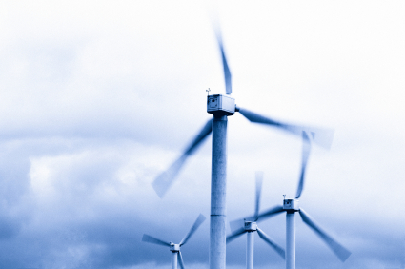
Green Energy Jobs
Solar
Energy Efficiency
Wind
Biomass
Geothermal
Utilities

Slide 3
VC Clean Energy Investment
2001 - $40.6 Billion = 0.9%
2009 - $17.7 Billion = 12.5%

Slide 4
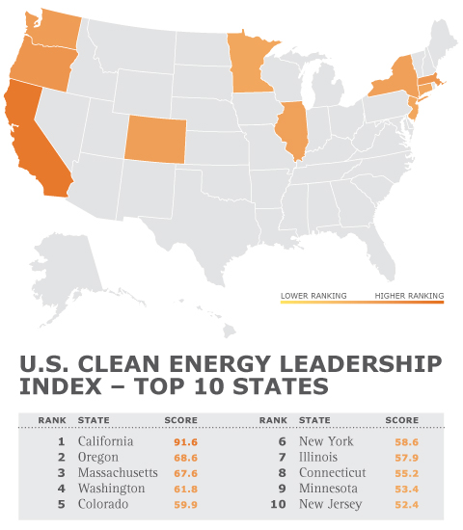

Slide 5
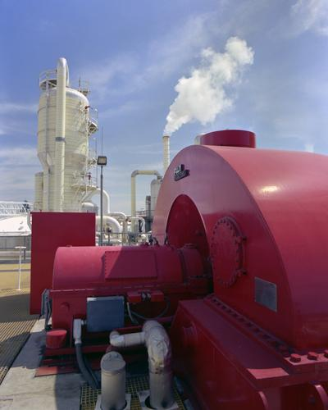
Annual Growth Rate
Wind = 30.7%
Solar = 29.5%
Biomass = 1.4%
Geo = 0.7%
Prior to Economic Downturn

Slide 6
California’s per capita energy consumption over the past 30 years has remained flat
The U.S. per capita energy consumption has increased by 50% over the same period

Slide 7
Between 2006 and 2008, PG&E invest nearly $1 billion in energy efficiency
SVLG have developed a “Clean and Green Energy Action Plan” for their member businesses.

Slide 8
CA Green Building Initiative requires state-owned facilities to be 20% more energy efficient by 2015.
AB32

Slide 9
Total Job Openings = 14,404
Average Wage = $24.86

Slide 10
Energy Auditor
Occupational Overview
Establish Customer Wants & Needs
Develop Implementation Strategies
Collect and Analyze Energy Consumption
Write Report
Criminal history
Have a valid driver’s license
Be able to pass a drug test

Slide 11

Energy Auditor
Knowledge & Skills
Math
Computer
Understanding Plans
Engineering Principles
Electrical Usage
Basic Physics & Chemistry
Building, Electrical, & Plumbing Codes

Slide 12
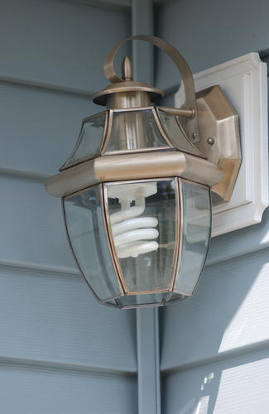
Energy Auditor
Worker Behaviors
Reliability
Customer Service
Able to Communicate Well
Be a Team Player
Safety First

Slide 13
Energy Auditor
Major Duties
Inspection
Data Collection / Field Measurements
Energy Consumption
Analysis
Cost - Benefit
Recommendation / Feasibility Study
Audit Report

Slide 14
Green Building
Occupational Overview
Building Design Concepts
Drawings & Permitting
Water and Energy Modeling
Building Material Selection
Budgeting
Research & Analysis

Slide 15
Green Building
Knowledge & Skills
Building Modeling
Local Codes
Math
Read Plans
Computer Software
Communicate Written and Verbally
Energy and Water

Slide 16
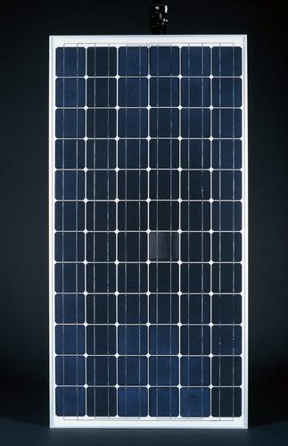
Green Building
Worker Behaviors
Detail Oriented
Communication
Independent
Safe
Respectful
Vision

Slide 17
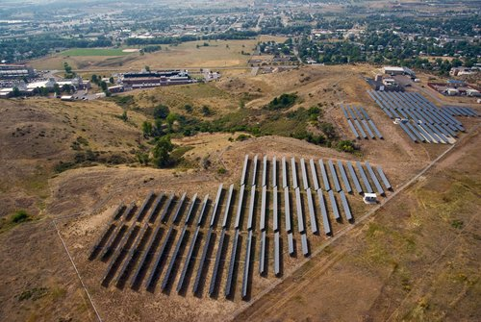
Green Building
Major Duties
Assess the Site
Engineer the System
Produce Plans
Identify Materials
Optimize Building Systems
Maintain and Organize Resources / Documentation

Slide 18
Green Building
I am comfortable on a roof and pitches and have no fear of heights.
I am able to perform mathematical calculations
I can lift 50-75lbs.
I have basic electrical background
I have background in general construction or in roofing.

Slide 19
Green Building
I understand the importance of applying safety principles in this workplace.
I have a high school diploma/GED
I have a valid driver’s license and good driving record
Computer Aided Design

Slide 20
Alternative Fuels
Diagnosis
Maintenance
Repair

Slide 21
Alternative Fuel
Knowledge & Skills
Basic Computer
Mechanical
Math
Communication Skills
Documentation & Record Keeping
Reading & Comprehension
Safety

Slide 22
Alternative Fuel
Worker Behavior
Customer Focused
Problem Solver
Detail
Independent
Time Management

Slide 23
Alternative Fuel
Major Duties
Service (Diagnosis & Repair)
  Brake System
  Engine
  Fuel System
  Electrical System,
  HVAC System
  Steering / Suspension
  Drive Line (Transmission)
  Documentation & Record Keeping

Slide 24
Resources Developed
Introduction to Energy Course
Energy Auditor Course
Green Building Course
Alternative Fuels Course
Four Energy Resources

Slide 25
Introduction to Energy
Introduction to Energy Principles
  Ohm’s Law
  Thermodynamics
  Carbon Cycle
  Photosynthesis
Trends in Energy
Climate Change and Greenhouse Gases
Notes:
The students need to understand the principles of energy, where it comes from, how it is transfered

Slide 26
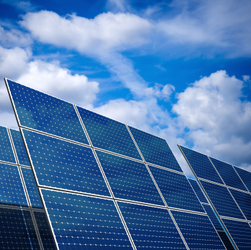
Introduction to Energy
Renewable Energy
Green Building
Alternative Fuels
Energy Efficiency

Slide 27
Energy Auditor
Energy and Energy Efficiency Fundamentals
Energy Calculations
Energy Consumers and Efficiency Measures
  Lighting & Controls
    Indoor
    Outdoor
  Electrical Devices (plug loads)
  Heating, Ventilation and Air Conditioning (HVAC)
  Building Envelope – Weatherization

Slide 28
Energy Auditor
Energy Audit Best Practices
Practice Energy Audits
  Residential
  Small Commercial
  Large Commercial / Industrial
Energy Auditor Certification Programs
Notes:
It is imperative that we distinguish between residential and commercial – they are very different

Slide 29
Green Building
Factors affecting green building adoption.
    Economic issue
    Socio-cultural issues
    Technological issues
    Political issues
Current practices and technologies
    Energy
    Water
    Waste
    Indoor Air Quality
    Land Use

Slide 30
Green Building
Tools and resources for green building
    Energy Modeling
    Life Cycle Assessment
    Construction practices
Current Green Building Programs
    LEED
    Build It Green
    EnergyStar
Emerging codes and regulations
    California Green Building Code
    AB 32 – Global Warming Solutions Act
    SB 375
    Others as relevant

Slide 31
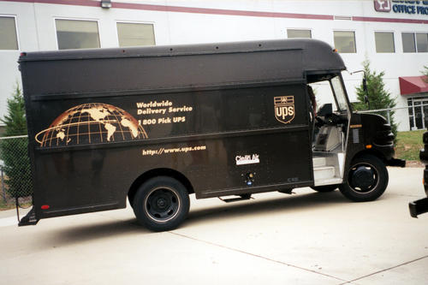
Alternative Fuels
Electric / Hybrid
Biofuel
Hydrogen
Compressed Natural Gas (CNG)
Liquid Natural Gas (LNG)

Slide 32
Alternative Fuels
Diagnosis
Repair
Maintenance
NFPA – 52 – National Fire Protection
Fuel Storage &Delivery Components
DVOM - Digital Volt Ohm Metering

Slide 33
Alternative Fuels
Fuel Safety and Safety Procedures
Emission Controls
Fuel Properties & Fueling
Government Regulations
Industry Standards and Guidelines
Customer Relationship

Slide 34


Slide 35
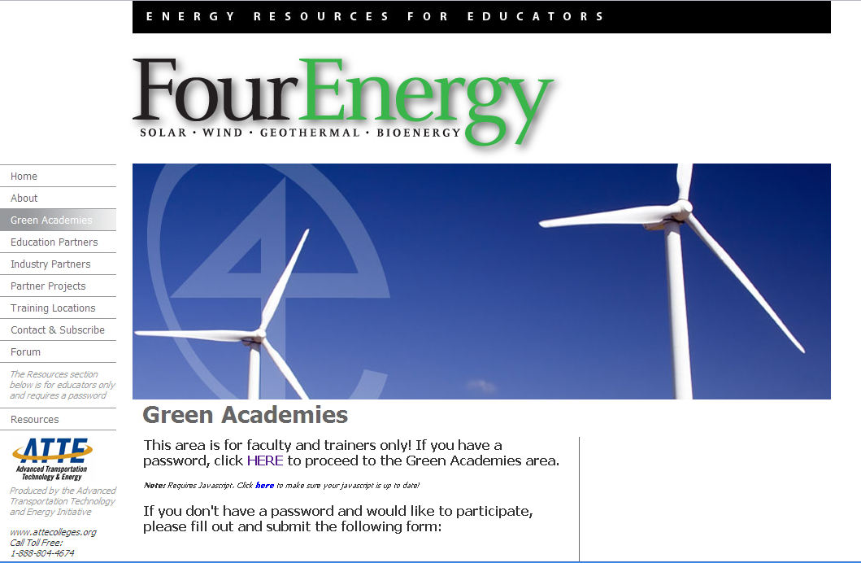

Slide 36
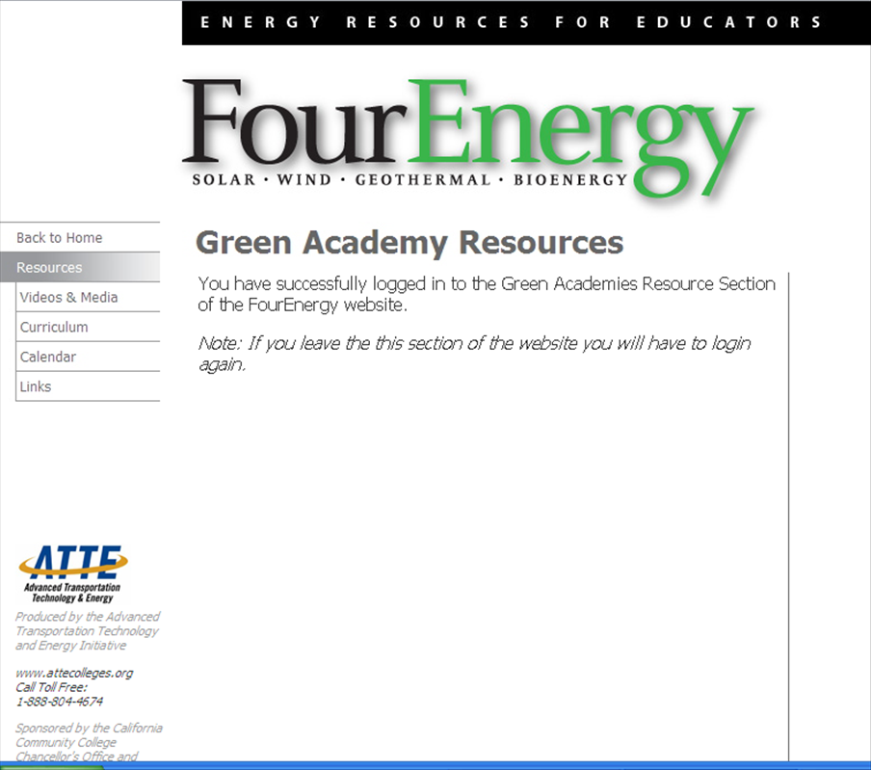

Slide 37
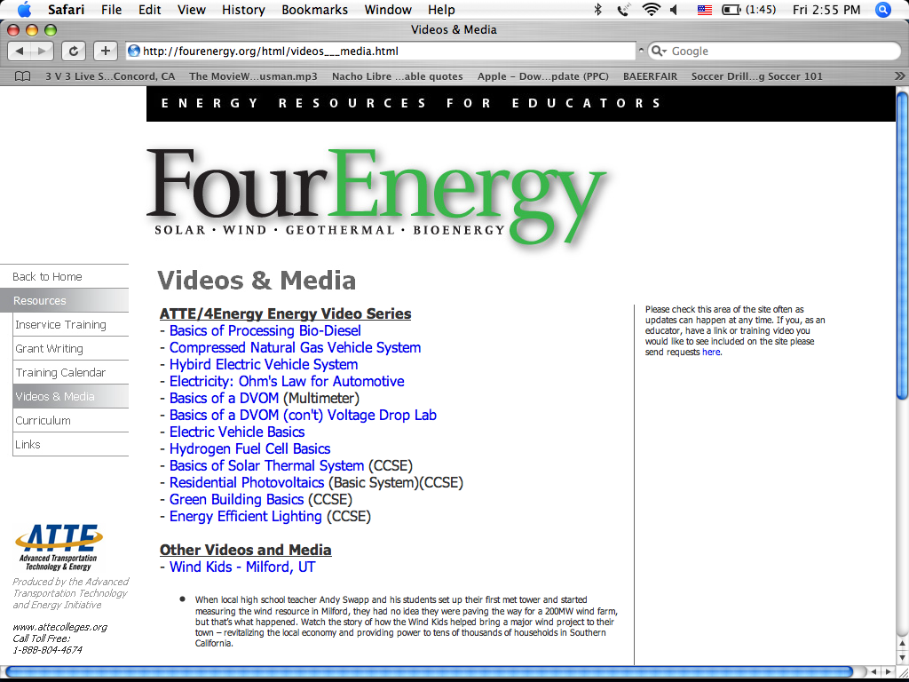

Slide 38
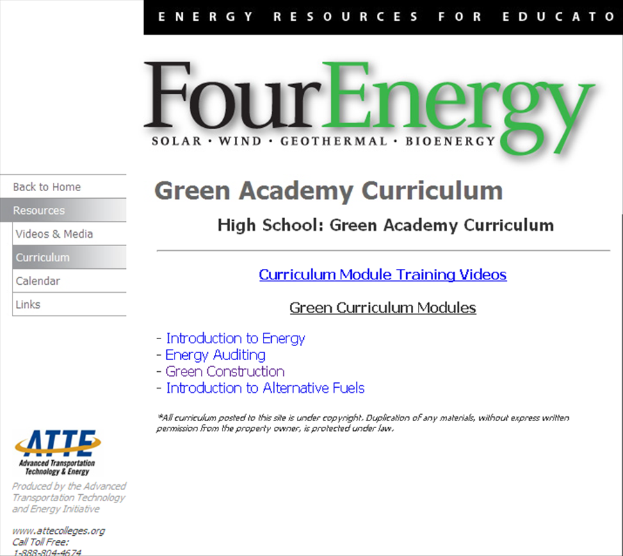

Slide 39
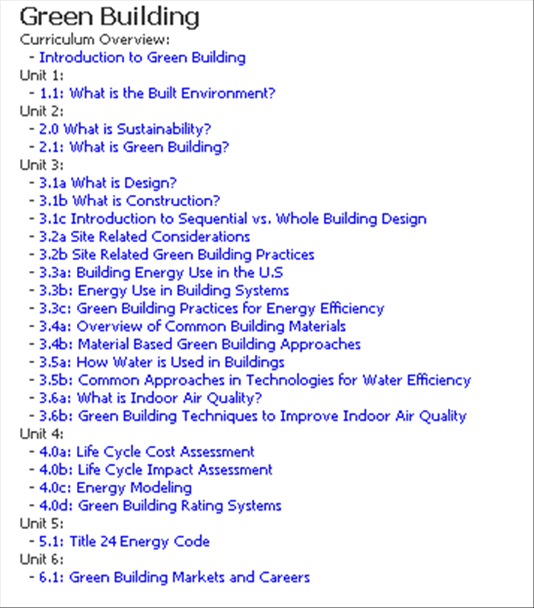

Slide 40
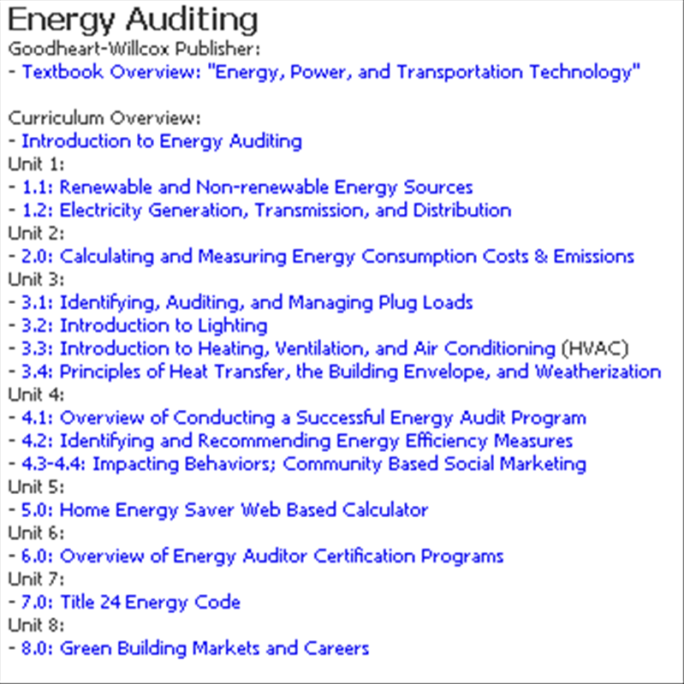

Slide 41
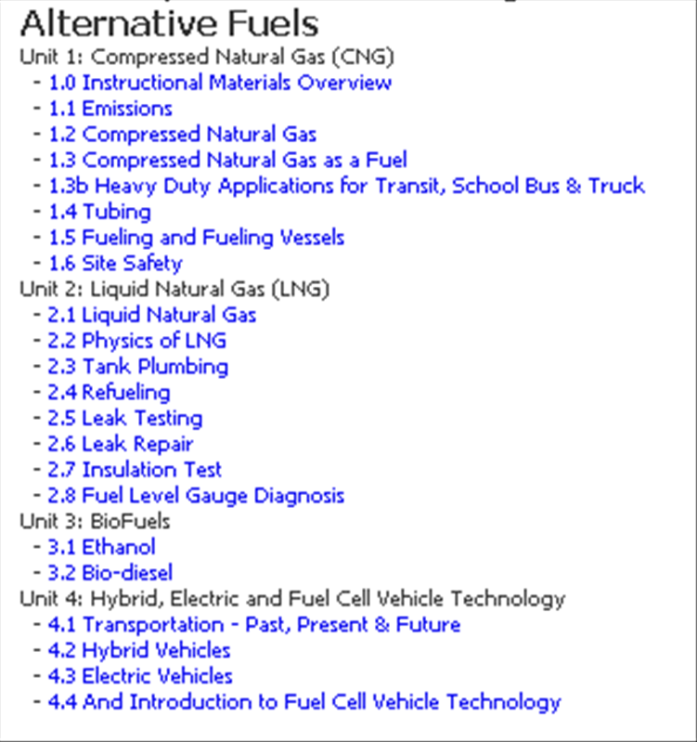

Slide 42
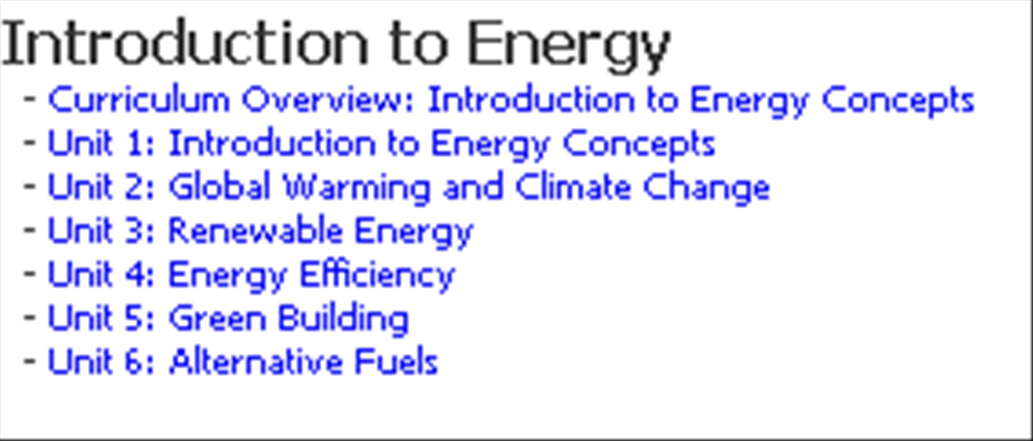

Slide 43
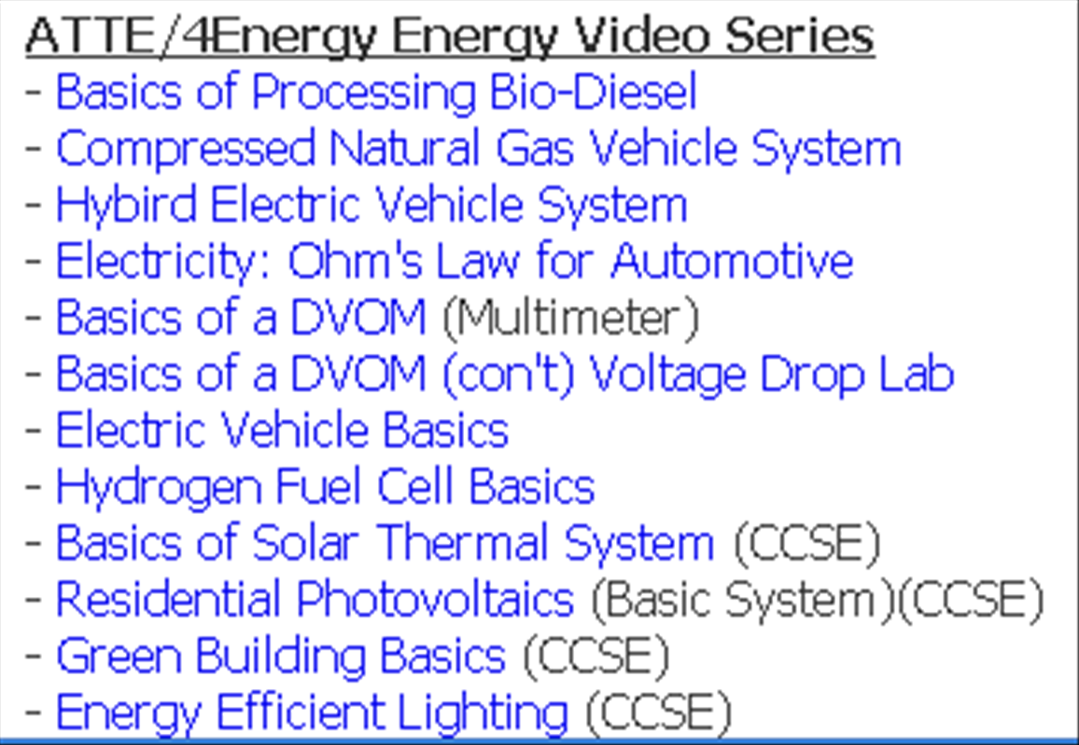

Slide 44
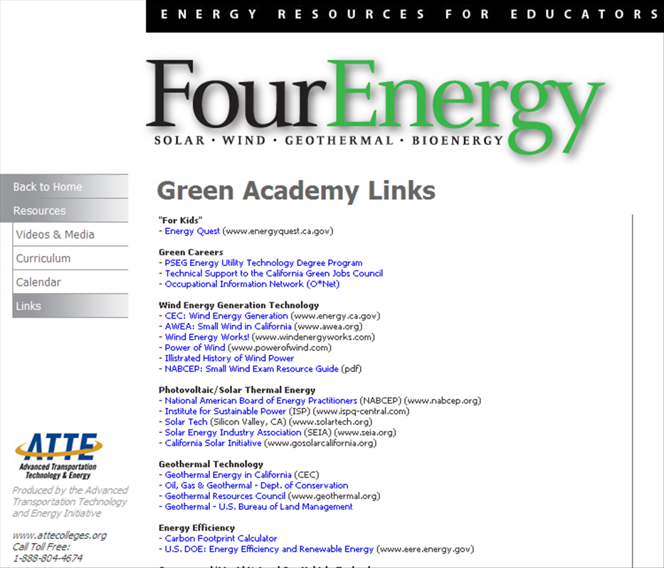

Slide 45
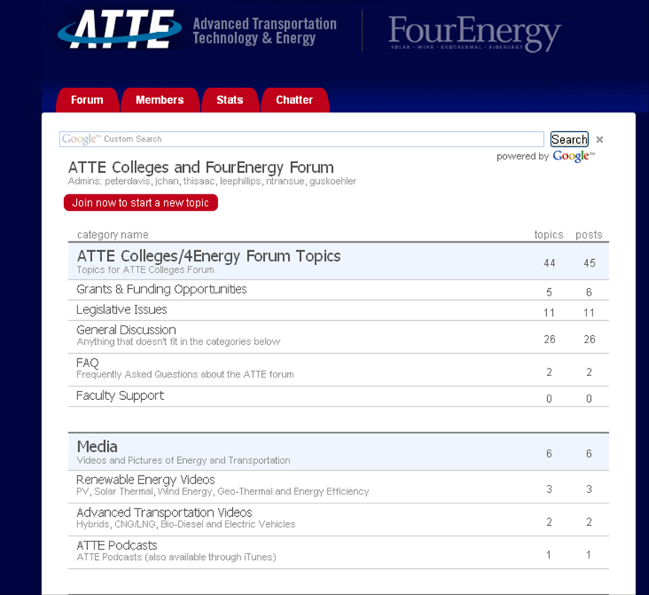

Slide 46
